Slide 1

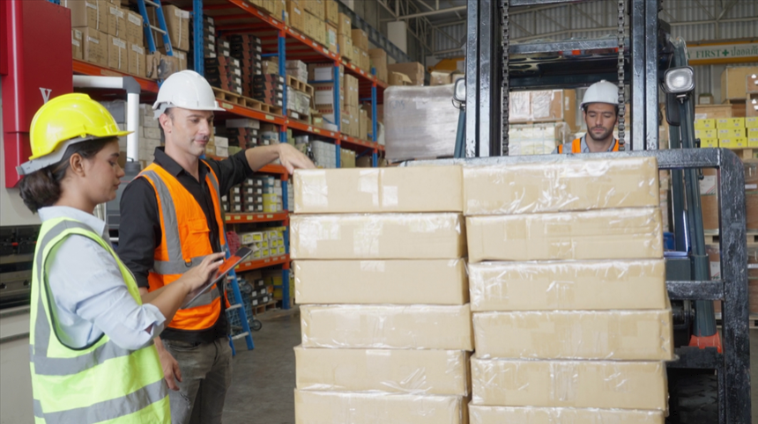
Safe Forklift Operation
©2023 BLR®, a division of Simplify Compliance LLC
2311
Notes:
Welcome to BLR® training.

Slide 2

About This Module
OVERVIEW
LEARNING
OBJECTIVES
Operating a forklift is a big responsibility, and it’s one that requires you to pay attention to safety at all times. Forklifts are useful for moving heavy loads, but remember that they are powerful machines that can be extremely dangerous if operated incorrectly.
This course is designed to help you become a better and safer forklift operator. If you’re an experienced operator, this course may remind you of safe habits and work practices that you might have forgotten. If you’re a new operator, this course will describe the operating practices you need to follow to be a safe operator.
Reviewing this course by itself will not make you a good forklift driver. It’s up to you to put what you learn into practice so that you can become a safe and responsible operator.

Slide 3
About This Module
OVERVIEW
LEARNING
OBJECTIVES
At the completion of this module, the participant will be able to:
Be familiar with how a forklift works.
Recognize how operating a forklift is different from driving a car.
Demonstrate the basic principles of operating a forklift safely and skillfully.
Identify the hazards of operating a forklift in the workplace.
Inspect and maintain a forklift properly.

Slide 4
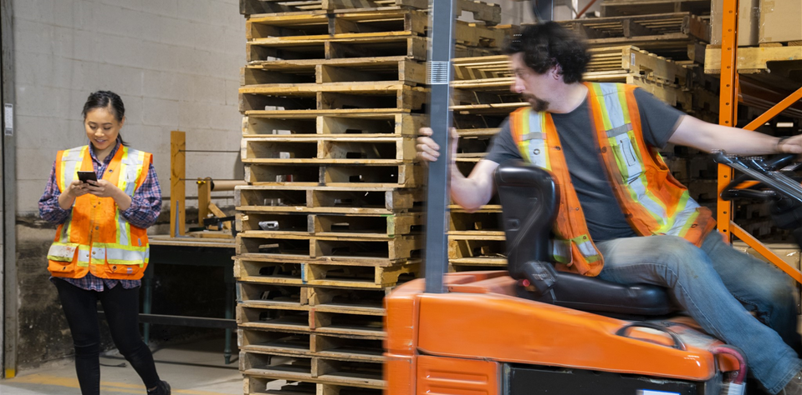
Why Forklift Training Is Necessary
Numerous fatalities each year
Tens of thousands of injuries annually
MOST ACCIDENTS CAN BE PREVENTED!
Notes:
Why is it necessary to have special training on forklift operation?
Forklifts can be dangerous. In an average year, at least one worker a week is killed in a forklift accident, and sometimes more. Some of those who die are forklift operators, and others are employees working near forklift operations.
In addition to deaths, tens of thousands of forklift-related injuries occur each year. Many of these result in lost workdays. Common forklift-related injuries result from:
Hitting a pedestrian with a forklift;
Forklift tipovers;
Improperly positioned loads;
Falling from the forks or from a platform positioned on the forks;
Falling from a ladder that is struck by a forklift; and
Being struck by materials that fall from a forklift.
Most accidents and injuries could be prevented with specialized forklift safety training.

Slide 5
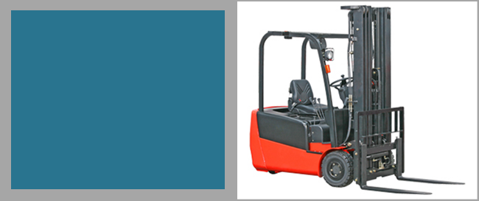
Parts of a Forklift
Introduction
First, let's take a look at the parts of a forklift.
Notes:
First, let’s take a look at the parts of a forklift.

Slide 6
Parts of a Forklift
Overhead Guard
The overhead guard protects you in the event of a tipover.
Notes:
Overhead Guard: The overhead guard protects you in the event of a tipover.

Slide 7
Parts of a Forklift
Lift Control
The lift control operates the forks up and down.
Notes:
Lift Control: The lift control operates the forks up and down.

Slide 8
Parts of a Forklift
Tilt Control
The tilt control operates the forks forward and back.
Notes:
Tilt Control: The tilt control operates the forks forward and back.

Slide 9
Parts of a Forklift
Mast
The mast houses the chains and the lifting gear.
Notes:
Mast: The mast houses the chains and the lifting gear.

Slide 10
Parts of a Forklift
Lift Cylinder
The lift cylinder is what actually powers the lift.
Notes:
Lift Cylinder: The lift cylinder is what actually powers the lift.

Slide 11
Parts of a Forklift
Lift Chains
Lift chains are used to lift heavy loads.
Lift chains are used to lift heavy loads.
Notes:
Lift Chains: Lift chains are used to lift heavy loads.

Slide 12
Parts of a Forklift
Forks
The forks are where the load actually sits.
Notes:
Forks: The forks are where the load actually sits.

Slide 13
Parts of a Forklift
Backrest
The backrest prevents the load from falling backward off the forks.
Notes:
Backrest: The backrest prevents the load from falling backwards off the forks.

Slide 14
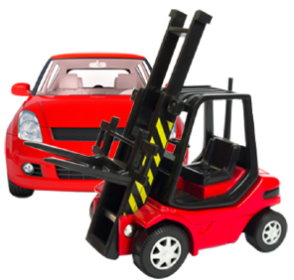
Forklift vs. Automobile
Turn Direction
Collision Impact
Driving Backward
One-Hand Driving
Forklifts behave differently from cars in a number of important ways.
Notes:
Forklifts behave differently than cars in a number of important ways. To review the differences.

Slide 15
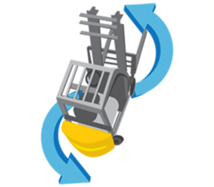
Forklift vs. Automobile
Turn Direction
Turn Direction
Collision Impact
Driving Backward
One-Hand Driving
Unlike a car, the rear of a forklift swings in the opposite direction of the turn. For example, when turning left, the rear of the forklift swings to the right.
Notes:
Turn Direction: Unlike a car, the rear of a forklift swings in the opposite direction of the turn. For example, when turning left, the rear of the forklift swings to the right.

Slide 16
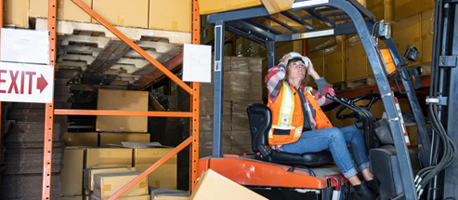
Forklift vs. Automobile
Collision Impact
Turn Direction
Collision Impact
Driving Backward
One-Hand Driving
The impact of a forklift when hitting other objects is magnified compared with a car because of its greater mass. A forklift hitting an object at 5 miles per hour does the same damage as a car going 30 miles per hour.
Notes:
Collision Impact: The impact of a forklift when hitting other objects is magnified compared with a car because of its greater mass. A forklift hitting an object at 5 miles per hour does the same damage as a car going 30 miles per hour.

Slide 17
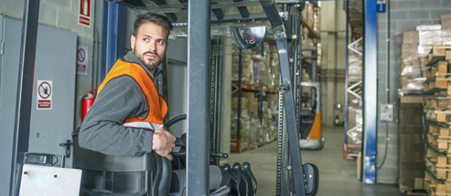
Forklift vs. Automobile
Driving Backward
Turn Direction
Collision Impact
Driving Backward
One-Hand Driving
Forklifts are often driven backward, especially when unloading cargo or when carrying a load that obstructs the forward view, as opposed to a car, in which reverse driving is rare.
Notes:
Driving Backward: Forklifts are often driven backward, especially when unloading cargo or when carrying a load that obstructs the forward view, as opposed to a car, in which reverse driving is rare.

Slide 18
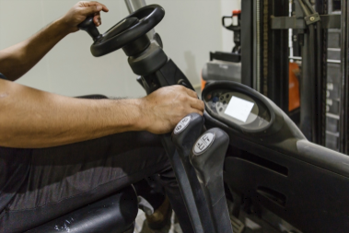
Forklift vs. Automobile
One-Hand Driving
Turn Direction
Collision Impact
Driving Backward
One-Hand Driving
Forklifts are operated with one hand on the wheel and the other hand on the controls, whereas a car is generally driven with both hands.
Notes:
One-Hand Driving: Forklifts are operated with one hand on the wheel and the other hand on the controls, whereas a car is generally driven with both hands.

Slide 19
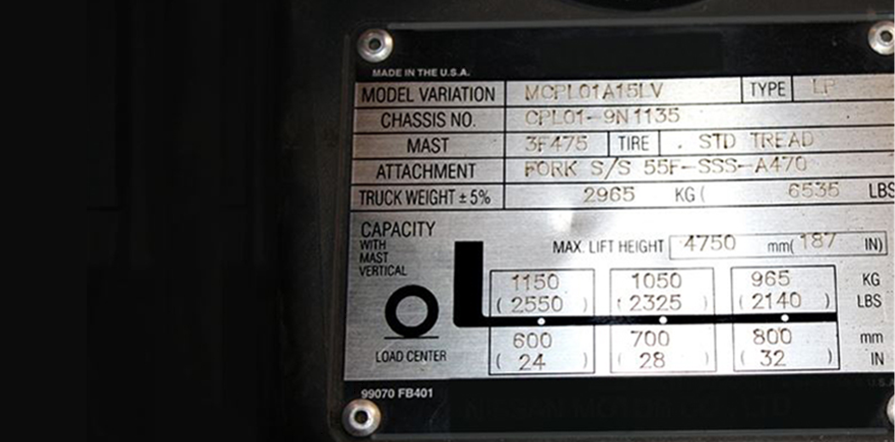

Nameplate
Type and fuel
Attachments
Tires
Weight
Capacity
Notes:
The nameplate (also called the data plate) provides important information for the forklift operator. OSHA requires all forklifts to have legible nameplates specific to the forklift and any attachments it has. Report any forklift that doesn’t have a nameplate or if the nameplate is not legible.
The nameplate tells you:
The type of forklift and the fuel it uses;
Attachments;
Proper tire size and pressure;
The weight of the forklift;
The capacity of the forklift; and
The load center of the forklift.
For you, these last two-the capacity and load center-are probably the most important pieces of information on the nameplate. The capacity is the maximum weight of a load that can be safely lifted to the forklift’s maximum height, assuming the center of gravity of the load is within the rated load center. And the load center is the distance between the vertical face of the forks and the center of gravity of the load.
Take a moment to study the nameplate shown here and become familiar with how to find the information you need for safe operation.

Slide 20
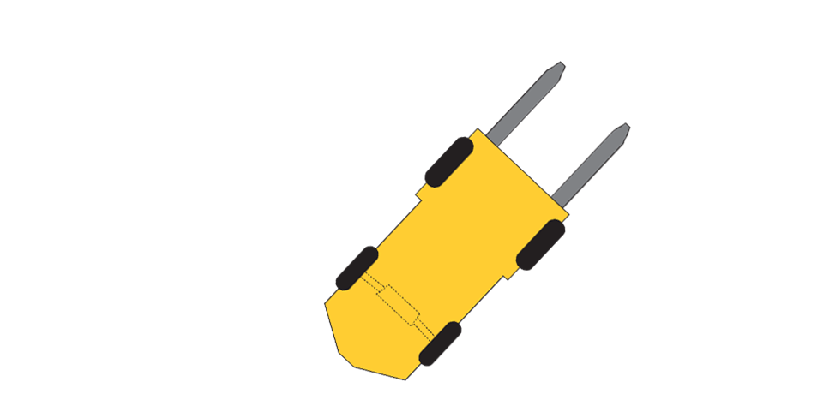
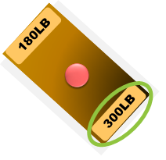
Determine a Load’s Center of Gravity
Center of gravity is the balance point
Inconsistent loads will change center of gravity
Pick up load on the side closest to its center of gravity
Notes:
Let’s learn more about the center of gravity of a load and why it’s important to understand what it means.
The center of gravity is the balance point of the load-that is, the exact point on which the entire load will balance. For loads that are composed of similar material, the balance point will be near the center of the load.
If the load is inconsistent-that is, it contains materials of different weights and densities-the center of gravity will be on the side with the heaviest mass. For example, if a pallet contains 100 pounds of bricks on one side and 20 pounds of pillows on the other, the center of gravity would be closer to the side with the bricks.
If possible, a load should always be picked up on the side that is closest to the center of gravity. This helps keep the weight of the load closer to the forklift and reduces the risk of the load falling off or causing the forklift to tip over.

Slide 21
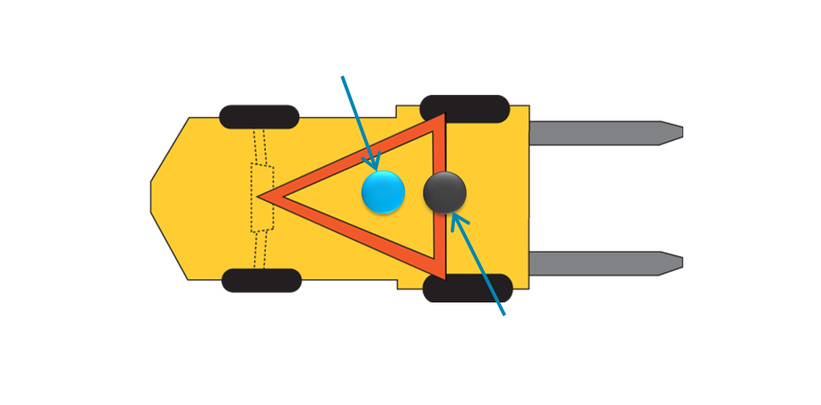
Stability Triangle
Vehicle Center of Gravity (unloaded)
Vehicle Center of Gravity (with maximum rated load)
Notes:
The “stability triangle” is another safety issue that operators should always keep in mind when operating a forklift to avoid actions that could cause the forklift to tip over.
A typical forklift has a three-point suspension with the weight supported by the two front tires and the center of the rear axles. This creates a triangle.
Its center of gravity is shown by the blue circle on the diagram, right in the middle of the triangle, which is also right below where the operator sits.
For safe operation, the center of gravity of a forklift that is carrying a load must stay within this stability triangle, or the forklift will tip over.
The center of gravity when the forklift is carrying its maximum rated load is different from when the forklift is empty. The center of gravity with a maximum rated load is shown by the black circle, near the front edge of the stability triangle but still within the triangle.
The stability triangle is an effective way to show how your actions can cause a lift truck to tip over so that you know what actions to avoid. This information on stability is primarily for sit-down counterbalance lift trucks. Other lift trucks, such as stand-up narrow aisle, will have different stability concerns.

Slide 22
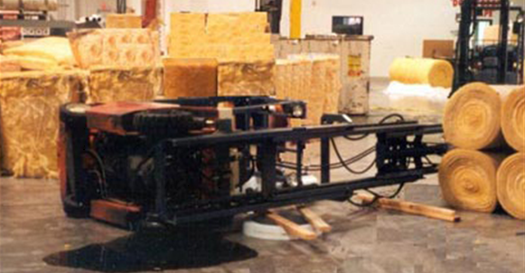
What Can Cause a Tipover?
Center of Gravity on the Side
Center of Gravity in the Front
Center of Gravity in the Rear
Notes:
Three examples of how a forklift can tip over.

Slide 23
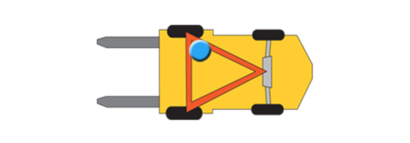
What Can Cause a Tipover?
Center of Gravity on the Side
Center of Gravity on the Side
Center of Gravity in the Front
Center of Gravity in the Rear
A tipover can occur if the center of gravity is on the side of the stability triangle. This might be caused by turning a corner, having an unbalanced load, driving into a pothole, or traveling on a sloping surface.
Notes:
Center of Gravity on the Side: A tipover can occur if the center of gravity is on the side of the stability triangle. This might be caused by turning a corner, having an unbalanced load, driving into a pothole, or traveling on a sloping surface.

Slide 24
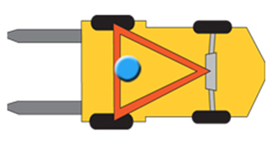
What Can Cause a Tipover?
Center of Gravity in the Front
Center of Gravity on the Side
A tipover can occur if the center of gravity is near the front of the stability triangle. This might be caused by:
The forklift carrying its maximum load
The mast tipping forward
The forklift stopping abruptly
The forklift quickly accelerating in reverse
Center of Gravity in the Front
Center of Gravity in the Rear
Notes:
Center of Gravity in the Front: A tipover can occur if the center of gravity is near the front of the stability triangle. This might be caused by:
The forklift carrying its maximum load;
The mast tipping forward;
The forklift stopping abruptly;
The forklift quickly accelerating in reverse.

Slide 25
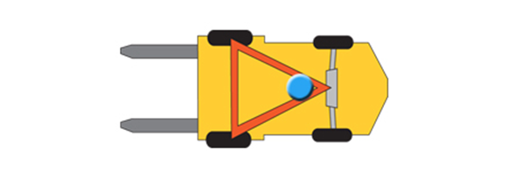
What Can Cause a Tipover?
Center of Gravity in the Rear
Center of Gravity on the Side
Center of Gravity in the Front
Center of Gravity in the Rear
A tipover can occur if the center of gravity is near the rear. This could be caused by tilting the mast back, stopping abruptly when traveling in reverse, quickly accelerating forward, or driving up a ramp.
Notes:
Center of Gravity in the Rear: A tipover can occur if the center of gravity is near the rear. This could be caused by tilting the mast back, stopping abruptly when traveling in reverse, quickly accelerating forward, or driving up a ramp.

Slide 26
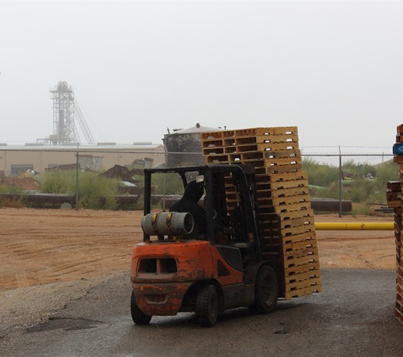
What Can Cause a Tipover? (cont.)
Turning corner going up a ramp
Abrupt stop with capacity load
Turning corner with unbalanced load
Notes:
Combinations of actions or circumstances could also cause the center of gravity to shift outside the stability triangle and tip the forklift. For example:
A forklift that turns a corner while driving up a ramp could shift the center of gravity too far backward and to the side, causing a tipover.
A forklift moving forward with a capacity load could tip forward if forced to stop abruptly.
A forklift turning a corner with an unbalanced load could tip over if it hit a pothole.

Slide 27
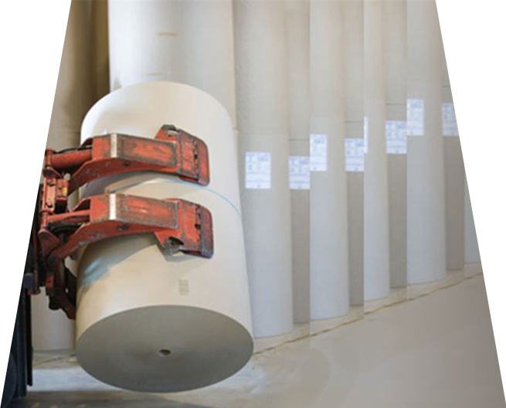
Attachments
Operating clearances
Capacity
Stability and load center
Photo courtesy of grainger.com
Notes:
Forklift attachments, such as carton clamps, drum clamps, paper-roll clamps, rotators, and push-pull elements, can affect the capacity of a forklift in a number of ways.
Attachments can change operating clearances by extending the length and width of the forklift.
Attachments can change the capacity of the forklift by adding weight. For example, if the attachment weighs 1,000 pounds, the capacity of the load you can carry is reduced by 1,000 pounds.
Attachments usually change the stability and center of gravity of the forklift as well. For example, if an attachment moves the load away from the vertical face of the forks, the maximum load the forklift can carry will be reduced.

Slide 28
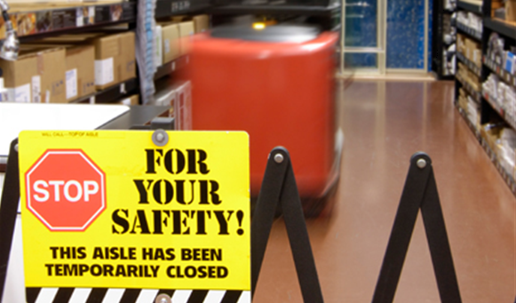
Operating Hazards: Pedestrians
Obstructed View
Blind Turns
Speeding
Unaware Pedestrians
Horseplay
Most accidents with forklifts involve pedestrians.
Notes:
Most accidents with forklifts involve pedestrians.

Slide 29
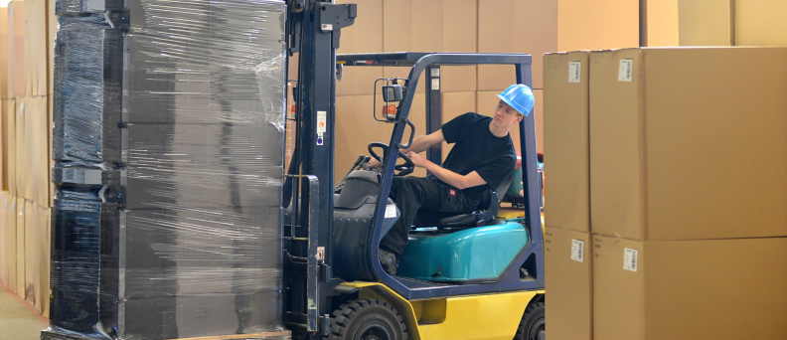
Operating Hazards: Pedestrians
Obstructed View
Obstructed View
Blind Turns
Speeding
Unaware Pedestrians
Horseplay
Having an obstructed view is a common hazard. The operator can’t see the pedestrian because of a load or an obstruction in the path.
Notes:
Obstructed View: Having an obstructed view is a common hazard. The operator can’t see the pedestrian because of a load or an obstruction in the path.

Slide 30
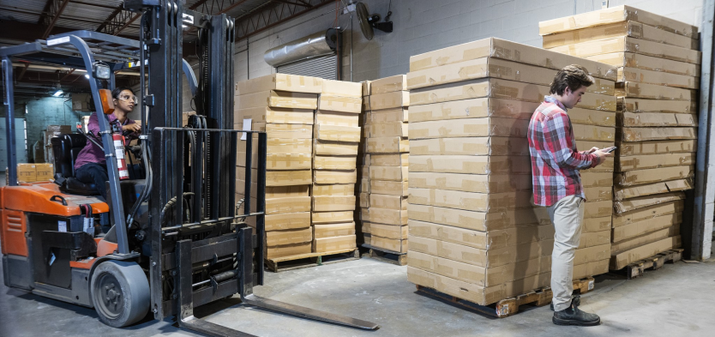
Operating Hazards: Pedestrians
Blind Turns
Obstructed View
Blind Turns
Speeding
Unaware Pedestrians
Horseplay
Turning the forklift around a corner toward a pedestrian who is in front of or alongside the forklift creates another hazard.
Notes:
Blind Turns: Turning the forklift around a corner toward a pedestrian who is in front of or alongside the forklift creates another hazard.

Slide 31
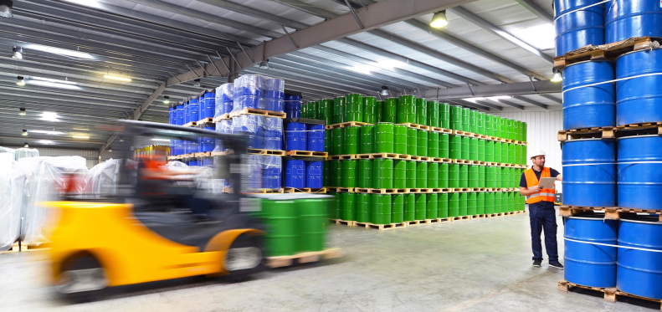
Operating Hazards: Pedestrians
Speeding
Obstructed View
Blind Turns
Speeding
Unaware Pedestrians
Horseplay
Speeding so that the forklift can’t stop in time to avoid the pedestrian often causes accidents involving pedestrians.
Notes:
Speeding: Speeding so that the forklift can’t stop in time to avoid the pedestrian often causes accidents involving pedestrians.

Slide 32
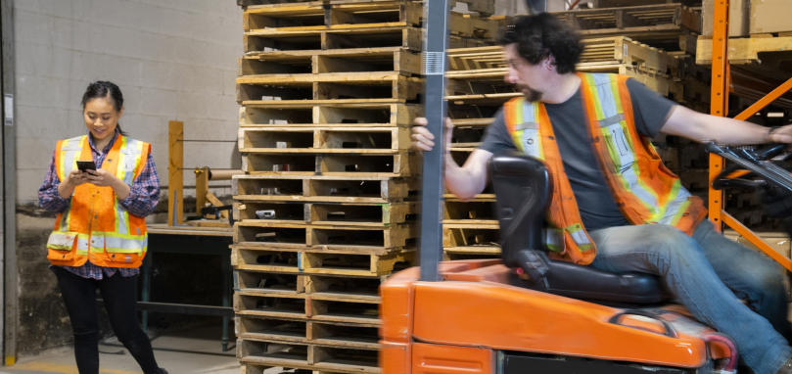
Operating Hazards: Pedestrians
Unaware Pedestrians
Obstructed View
Blind Turns
Speeding
Unaware Pedestrians
Horseplay
Another hazard arises when pedestrians are unaware of a forklift nearby.
Notes:
Unaware Pedestrians: Another hazard arises when pedestrians are unaware of a forklift nearby.

Slide 33
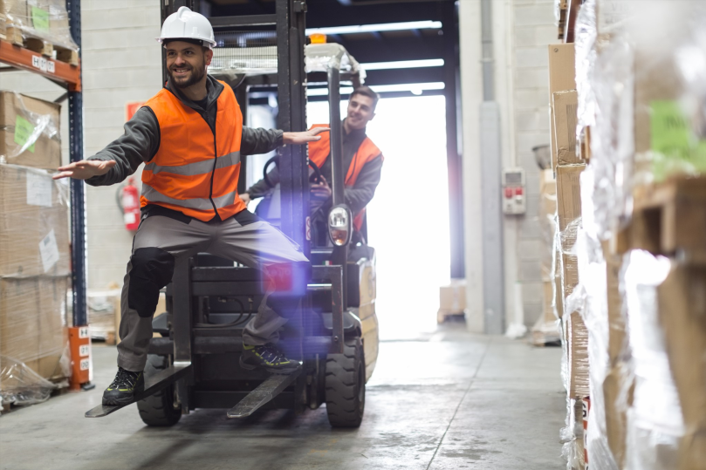
Operating Hazards: Pedestrians
Horseplay
Obstructed View
Blind Turns
Speeding
Unaware Pedestrians
Horseplay
Carrying passengers on the forklift is forbidden, as is any kind of horseplay on or near a forklift. Both of these safety violations create pedestrian hazards and lead to accidents.
Notes:
Horseplay: Carrying passengers on the forklift is forbidden, as is any kind of horseplay on or near a forklift. Both of these safety violations create pedestrian hazards and lead to accidents.

Slide 34
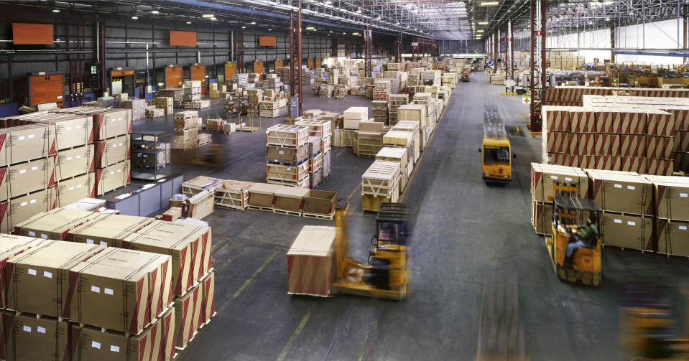
Operating Hazards: Environmental Conditions
Fuel
Ramps
Railroad Tracks
Slippery Floors
Dirt/Gravel
Poor Lighting
Other Hazards
Some forklift hazards are caused by the conditions present in the environment where the forklift is operating.
Notes:
Some forklift hazards are caused by the conditions present in the environment where the forklift is operating.

Slide 35
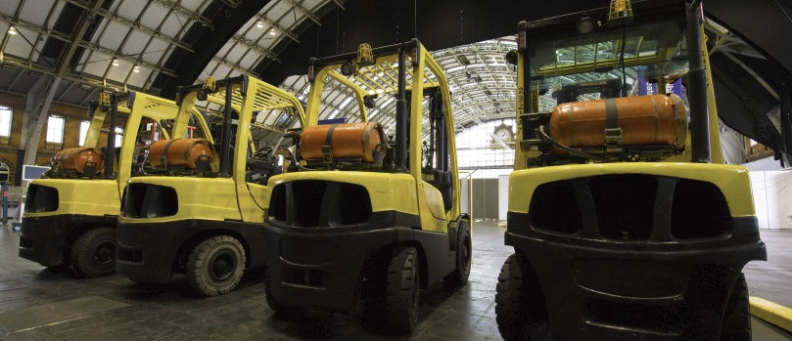
Operating Hazards: Environmental Conditions
Fuel
Fuel
Ramps
Railroad Tracks
Slippery Floors
Dirt/Gravel
Poor Lighting
Other Hazards
Using a combustible fuel-operated forklift in a poorly ventilated area could allow the buildup of carbon monoxide or carbon dioxide from the forklift.
Notes:
Fuel: Using a combustible fuel-operated forklift in a poorly ventilated area could allow the buildup of carbon monoxide or carbon dioxide from the forklift.

Slide 36
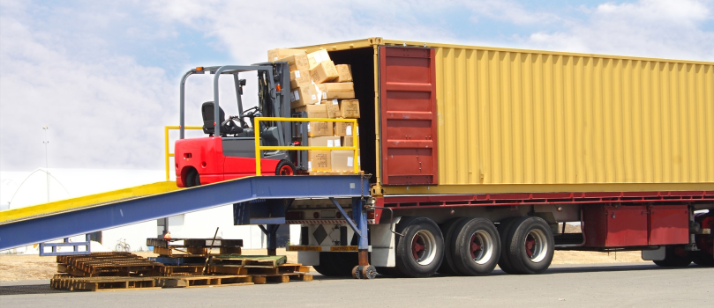
Operating Hazards: Environmental Conditions
Ramps
Fuel
Ramps
Railroad Tracks
Slippery Floors
Dirt/Gravel
Poor Lighting
A work environment with ramps can increase the chance of a forklift accident. For example, going up or down could destabilize the forklift, or the forklift could come too close to an edge and go over.
Other Hazards
Notes:
Ramps: A work environment with ramps can increase the chance of a forklift accident. For example, going up or down could destabilize the forklift, or the forklift could come too close to an edge and go over.

Slide 37
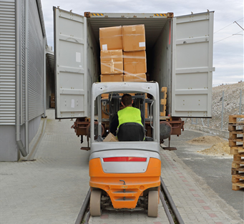
Operating Hazards: Environmental Conditions
Railroad Tracks
Fuel
Ramps
Railroad Tracks
Slippery Floors
Dirt/Gravel
Poor Lighting
Other Hazards
Crossing railroad tracks could unbalance a forklift.
Notes:
Railroad Tracks: Crossing railroad tracks could unbalance a forklift.

Slide 38
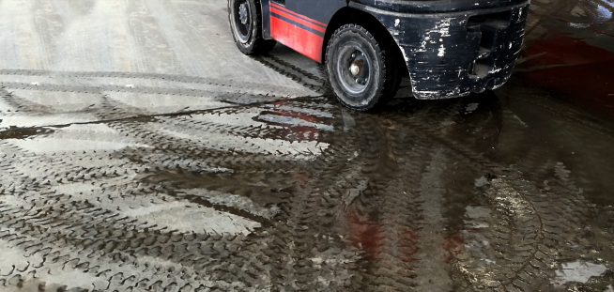
Operating Hazards: Environmental Conditions
Slippery Floors
Fuel
Ramps
Railroad Tracks
Slippery Floors
Dirt/Gravel
Poor Lighting
Other Hazards
Operating and braking on slippery floors could cause a skid, resulting in an accident.
Notes:
Slippery Floors: Operating and braking on slippery floors could cause a skid, resulting in an accident.

Slide 39
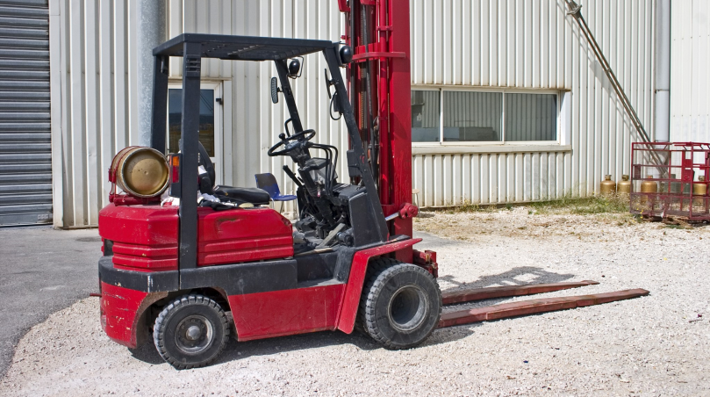
Operating Hazards: Environmental Conditions
Dirt/Gravel
Fuel
Ramps
Railroad Tracks
Slippery Floors
Dirt/Gravel
Poor Lighting
Other Hazards
Operating on dirt and gravel can be dangerous and lead to accidents.
Notes:
Dirt/Gravel: Operating on dirt and gravel can be dangerous and lead to accidents.

Slide 40
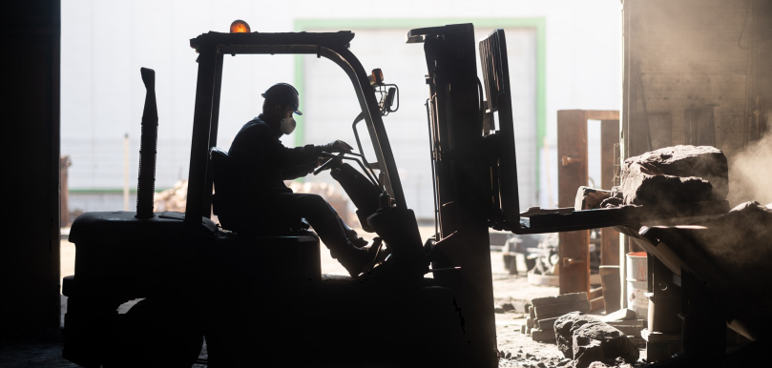
Operating Hazards: Environmental Conditions
Poor Lighting
Fuel
Ramps
Railroad Tracks
Slippery Floors
Dirt/Gravel
Poor Lighting
Other Hazards
Poor lighting can make it hard for you to see obstacles or pedestrians in your path.
Notes:
Poor Lighting: Poor lighting can make it hard for you to see obstacles or pedestrians in your path.

Slide 41
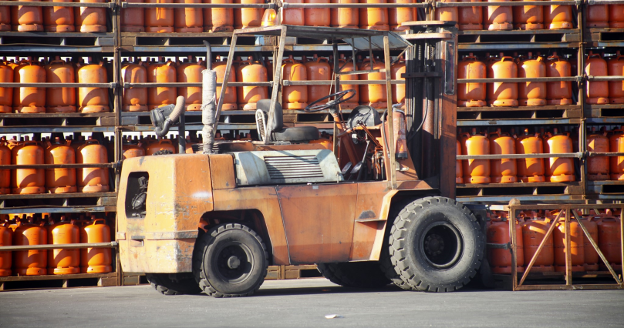
Operating Hazards: Environmental Conditions
Other Hazards
Fuel
Ramps
Railroad Tracks
Slippery Floors
Dirt/Gravel
Poor Lighting
There could be other hazards of a particular work environment that might cause a forklift accident. For example:
Pits or openings in the floor
Congested or narrow work spaces
The presence of flammable or combustible material
Other Hazards
Notes:
Other Hazards: Other hazards of a particular work environment might cause a forklift accident. For example:
Pits or openings in the floor;
Congested or narrow workspaces; and
The presence of flammable or combustible material.

Slide 42
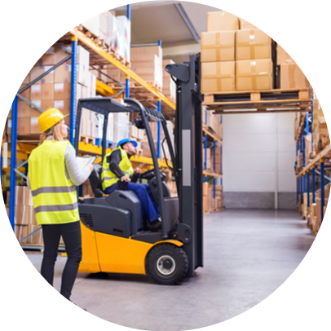
Operating Hazards: Load Carrying
Working around loading docks
Loads that block forward vision
Stacking and unstacking on racks
Notes:
Load-carrying hazards include:
Working around loading docks;
Carrying loads that block the forward vision; and
Stacking and unstacking on racks.
Do you know where hazards exist in your facility?

Slide 43
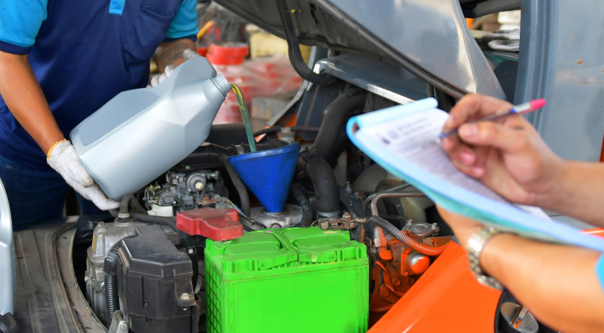
Preoperational Inspection: Walkaround
Start of Each Shift
Forklift Disengaged
Checklist
Tires, Axle, and Overhead Guard
Conducting the preoperational inspection is essential for safe forklift operation.
Notes:
Conducting the preoperational inspection is essential for safe forklift operation. Here is some information about the preoperational inspection: the walkaround.

Slide 44
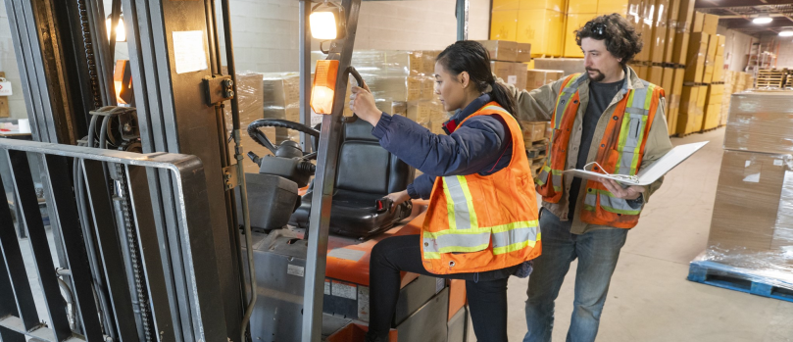
Preoperational Inspection: Walkaround
Start of Each Shift
Start of Each Shift
Forklift Disengaged
Checklist
Tires, Axle, and Overhead Guard
Conduct a preoperational walkaround inspection at the start of each work shift to ensure that the forklift will work properly and to identify maintenance problems before they cause an accident.
Notes:
Start of Each Shift: Conduct a preoperational walkaround inspection at the start of each work shift to ensure that the forklift will work properly and to identify maintenance problems before they cause an accident.

Slide 45
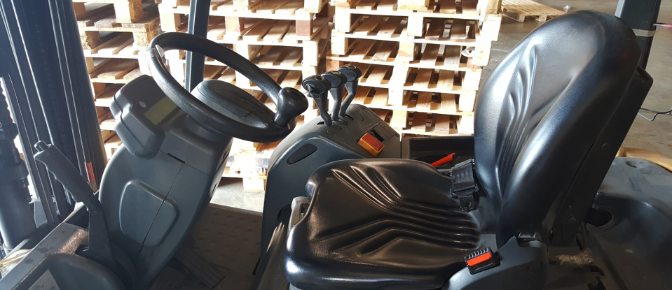
Preoperational Inspection: Walkaround
Forklift Disengaged
Start of Each Shift
Forklift Disengaged
Checklist
Tires, Axle, and Overhead Guard
Make sure that the forklift is properly disengaged, with the forks down, the key turned off, gear set in neutral, and parking brake on.
Notes:
Forklift Disengaged: Make sure that the forklift is properly disengaged with the forks down, the key turned off, gear set in neutral, and parking brake on.

Slide 46
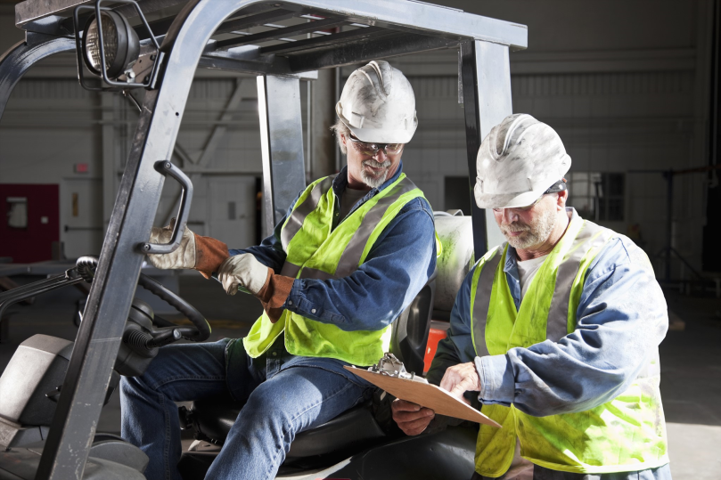
Preoperational Inspection: Walkaround
Checklist
Start of Each Shift
Forklift Disengaged
Checklist
Tires, Axle, and Overhead Guard
Follow the required preoperational inspection checklist. Don’t skip any items. When you’re done, complete and sign the checklist.
Notes:
Checklist: Follow the required preoperational inspection checklist. Don’t skip any items. When you’re done, complete and sign the checklist.

Slide 47
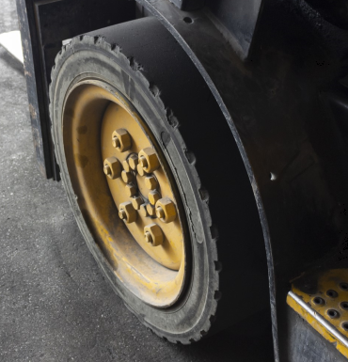
Preoperational Inspection: Walkaround
Tires, Axle, and Overhead Guard
Start of Each Shift
Walk to either side of the forklift and check:
The tires, making sure that there are no gouges, tears, or imbedded metal and that tires are properly inflated
Lug nuts
The axle to make sure it’s greased
The overhead guard to make sure there’s no debris lodged behind the mast
Forklift Disengaged
Checklist
Tires, Axle, and Overhead Guard
Notes:
Tires, Axle, and Overhead Guard: Walk to either side of the forklift and check:
The tires, making sure that there are no gouges, tears, or imbedded metal and that tires are properly inflated;
Lug nuts;
The axle to make sure it’s greased; and
The overhead guard to make sure there’s no debris lodged behind the mast.

Slide 48
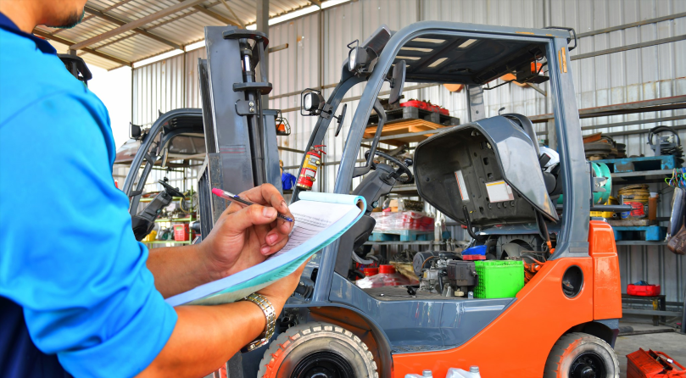
Preoperational Inspection: Walkaround (cont.)
Forks, Backrest, and Mast
Rear End
Propane-Powered Forklifts
Electric-Powered Forklifts
The First part of the preoperational inspection: the walkaround.
Notes:
Preoperational inspection: walkaround.

Slide 49
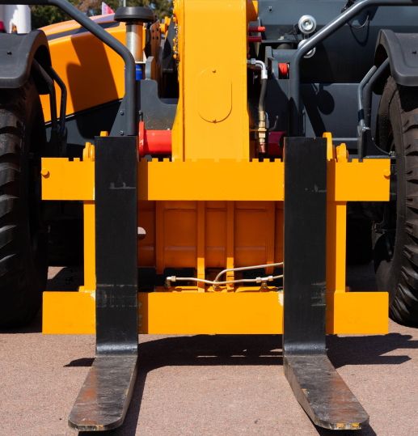
Preoperational Inspection: Walkaround (cont.)
Forks, Backrest, and Mast
Forks, Backrest, and Mast
Check the front of the forklift:
The forks should not be warped or bent.
Fork pins should be in place.
The backrest should be solid.
The mast and chains should be greased. All hoses should be free of leaks or rot.
Rear End
Propane-Powered Forklifts
Electric-Powered Forklifts
Notes:
Forks, Backrest, and Mast: Check the front of the forklift:
The forks should not be warped or bent.
Fork pins should be in place.
The backrest should be solid.
The mast and chains should be greased. All hoses should be free of leaks or rot.

Slide 50
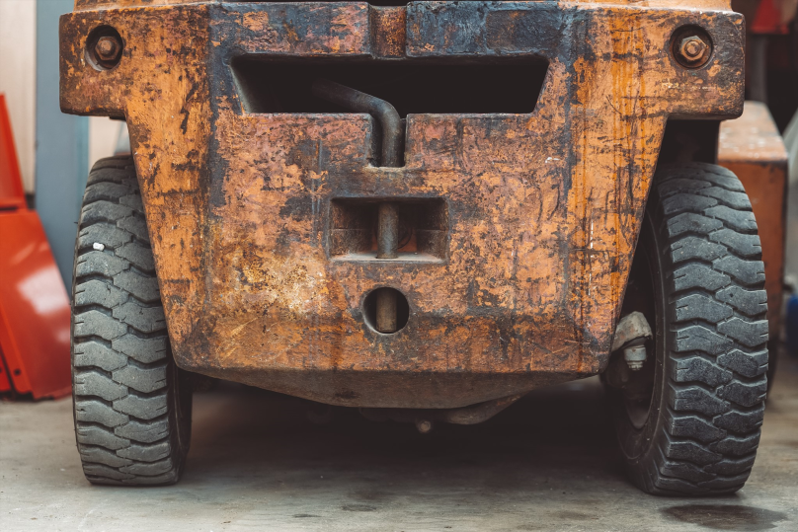
Preoperational Inspection: Walkaround (cont.)
Rear End
Forks, Backrest, and Mast
Rear End
Propane-Powered Forklifts
Electric-Powered Forklifts
Walk to the rear of the forklift, and check that the counterbalance bolt is tight and the radiator is clear of debris. Look on the floor around the forklift for oil or fluid leaks.
Notes:
Rear End: Walk to the rear of the forklift and check that the counterbalance bolt is tight and the radiator is clear of debris. Look on the floor around the forklift for oil or fluid leaks.

Slide 51
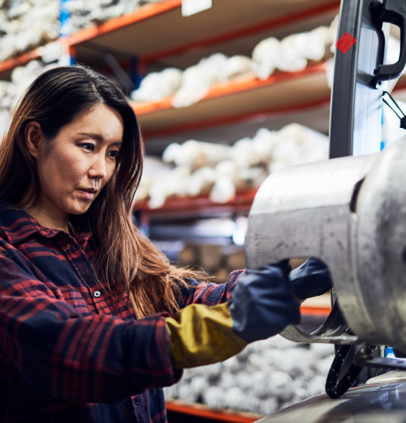
Preoperational Inspection: Walkaround (cont.)
Propane-Powered Forklifts
Forks, Backrest, and Mast
For propane-powered forklifts, lift the hood and inspect the engine. Check:
Oil and fluid levels
Cables
Fan belt, fan, and radiator
Tank and hose attachments
Rear End
Propane-Powered Forklifts
Electric-Powered Forklifts
Notes:
Propane-Powered Forklifts: For propane-powered forklifts, lift the hood and inspect the engine. Check:
Oil and fluid levels;
Cables;
Fan belt, fan, and radiator; and
Tank and hose attachments.

Slide 52
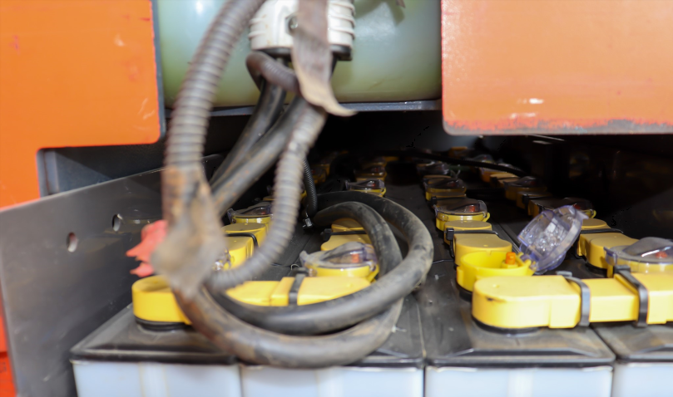
Preoperational Inspection: Walkaround (cont.)
Electric-Powered Forklifts
Forks, Backrest, and Mast
Rear End
Propane-Powered Forklifts
Electric-Powered Forklifts
For electric-powered forklifts, check the condition of the battery.
Notes:
Electric-Powered Forklifts: For electric-powered forklifts, check the condition of the battery.

Slide 53
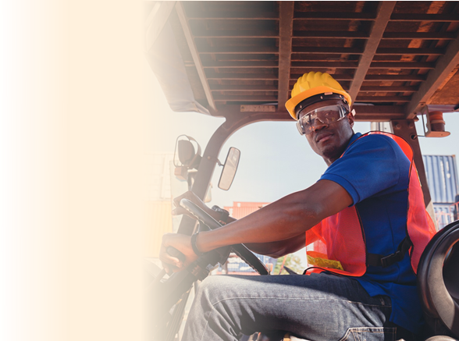
Preoperational Inspection: In the Operator's Seat
Nonmoving Check
Your preoperational inspection should continue when you sit in the operator seat.
Moving Check
Notes:
Your preoperational inspection should continue when you sit in the operator seat.

Slide 54
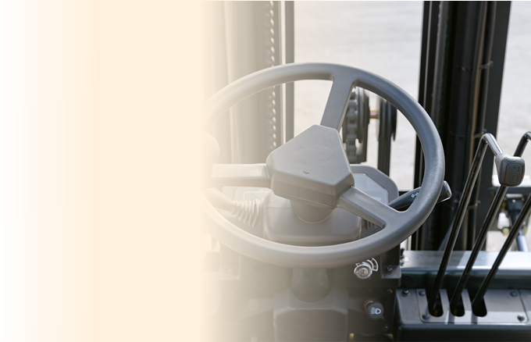
Preoperational Inspection: In the Operator's Seat
Before you start moving, check:
The seat belt
Gauges, light, and horn
Backup alarm and warning light
The tilt-and-lift mechanism
The parking brake
Nonmoving Check
Moving Check
Notes:
Nonmoving Check: Before you start moving, check:
The seat belt;
Gauges, light, and horn;
Backup alarm and warning light;
The tilt-and-lift mechanism; and
The parking brake.

Slide 55
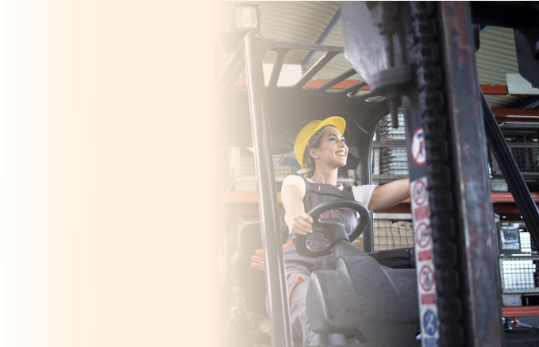
Preoperational Inspection: In the Operator's Seat
When the forklift is moving, check:
The running brakes by trying to stop quickly
The steering by doing full turns and listening for unusual noises
Nonmoving Check
Moving Check
Notes:
Moving Check: When the forklift is moving, check:
The running brakes by trying to stop quickly; and
The steering by doing full turns and listening for unusual noises.

Slide 56
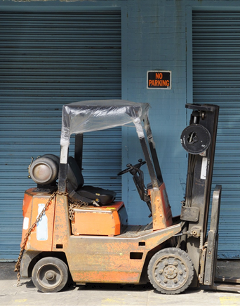
7 Basic Safety Rules for Operating a Forklift
Authorized operators only
Prompt accident reporting
Seat belt required
Nobody under the forks
No riders or horseplay
Operation from seat only
Parking
Notes:
These are fundamental safety rules for forklift operation. Be sure you understand them—and memorize them.
Only authorized drivers who have been through an approved training program may operate a forklift.
Always report any forklift-related accidents as quickly as possible.
Always wear your seat belt. It could save your life in the event of a tipover or collision.
No one should ever stand under upraised forks. If the hydraulic system fails, anyone standing under the forks could be killed.
No riders are allowed on the forks or on the back of the forklift. Horseplay on or around a forklift is strictly forbidden.
Operate the controls only when sitting in the driver’s seat.
Never park in a spot that could block exits or access to emergency equipment.

Slide 57
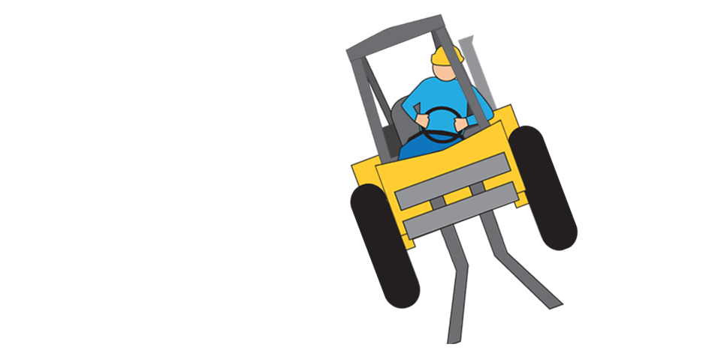
Tipover Safety Procedure
Stay seated
Hold on
Brace yourself
Lean away
Notes:
If you are ever in a forklift that tips over, you must follow the right procedure to avoid serious injury. Follow these important tips:
Stay in your seat and keep your seat belt on. Never try to jump clear. You could be crushed and killed by the overhead guard or the mast.
Firmly hold onto the steering wheel.
Brace your feet.
Lean away from the direction of the fall.

Slide 58
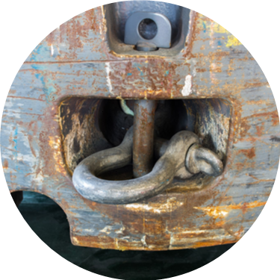
Loading and Unloading
Never overload
Locate center of gravity
Ensure stable load
Set forks properly
Tow from rear with towing pin
Notes:
Loading and unloading a forklift must always be done safely.
Never overload the forklift beyond its rated capacity. Check the capacity on the nameplate, and know how much your load weighs. It does not help to try to increase the capacity by adding weight to the rear of the forklift—in fact, this is very dangerous.
Be sure to locate the center of gravity of the load, and inspect the load for stability, projections, and damage to pallets before lifting it.
If the load is unstable, restack it, and if necessary, secure it with straps or ropes. For a wide load, spread the forks as wide as possible so that the load will fall inward if it becomes unstable. Remember that when loading or unloading and raising or lowering, the center of gravity changes.
Be sure forks are completely under the load before attempting to lift. The forks should go under at least 2/3 the length of the load.
Only use the rear towing pin for towing. Never drill a hole in the forks as a way to tow something or as a place for a chain hook. This ruins the integrity of the forks. Forklifts are equipped with a tow bar in the back for emergency towing. But not all forklifts are designed to tow all types of loads. Be sure to check the user’s manual for specific rules regarding towing. Safe attachments can be purchased for use when hoisting.

Slide 59
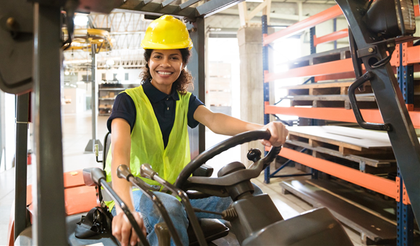
Rules of Travel
Direction of Travel
Cage
Forks
Horn
Speed
There are a number of very important safety rules to remember when traveling in a forklift.
Notes:
There are a number of very important safety rules to remember when traveling in a forklift.

Slide 60

Rules of Travel
Direction of Travel
Direction of Travel
Cage
Forks
Horn
Speed
Look in the direction you are traveling. This means looking behind you before and while backing up. You are required to travel with the load trailing if your forward view is obstructed.
Notes:
Direction of Travel: Look in the direction you are traveling. This means looking behind you before and while backing up. You are required to travel with the load trailing if your forward view is obstructed.

Slide 61

Rules of Travel
Cage
Direction of Travel
Cage
Forks
Horn
Speed
Keep your body inside the cage.
The cage is there to protect you.
Notes:
Cage: Keep your body inside the cage. The cage is there to protect you.

Slide 62

Rules of Travel
Forks
Direction of Travel
Cage
Forks
Horn
Speed
Keep the forks as low as possible while traveling. Avoid raising or lowering the forks until you are as close as possible to the destination.
Notes:
Forks: Keep the forks as low as possible while traveling. Avoid raising or lowering the forks until you are as close as possible to the destination.

Slide 63

Rules of Travel
Horn
Direction of Travel
Cage
Forks
Horn
Speed
Sound the horn at corners, aisles, doorways, and anywhere else you might not see someone or someone might not see you.
Notes:
Horn: Sound the horn at corners, aisles, doorways, and anywhere else you might not see someone or someone might not see you.

Slide 64

Rules of Travel
Speed
Direction of Travel
Cage
Forks
Horn
Speed
Don’t speed. A safe speed is one at which you can quickly and easily stop if you need to.
Notes:
Speed: Don’t speed. A safe speed is one at which you can quickly and easily stop if you need to.

Slide 65

Rules of Travel (cont.)
Clearance
Terrain
Pedestrians
Edges
Food and Drink
Here are some additional forklift traveling safety rules.
Notes:
Here are some additional forklift traveling safety rules.

Slide 66

Rules of Travel (cont.)
Clearance
Clearance
Terrain
Pedestrians
Edges
Food and Drink
Check your clearances. Check overhead before lifting a load, and check your turning clearance because the rear end of the forklift will swing wide.
Notes:
Clearance: Check your clearances. Check overhead before lifting a load and check your turning clearance because the rear end of the forklift will swing wide.

Slide 67

Rules of Travel (cont.)
Terrain
Clearance
Terrain
Pedestrians
Edges
Food and Drink
Avoid driving over loose objects or holes. Doing this could cause a tipover. If the tires lose traction, either the load is too heavy or the terrain is too slippery to operate safely.
Notes:
Terrain: Avoid driving over loose objects or holes. Doing this could cause a tipover. If the tires lose traction, either the load is too heavy or the terrain is too slippery to operate safely.

Slide 68

Rules of Travel (cont.)
Pedestrians
Clearance
Terrain
Pedestrians
Edges
Food and Drink
Always remember that pedestrians have the right of way.
Notes:
Pedestrians: Always remember that pedestrians have the right of way.

Slide 69

Rules of Travel (cont.)
Edges
Clearance
Terrain
Pedestrians
Edges
Food and Drink
Stay a safe distance from the edges of ramps and loading docks.
Notes:
Edges: Stay a safe distance from the edges of ramps and loading docks.

Slide 70


Rules of Travel (cont.)
Food and Drink
Clearance
Terrain
Pedestrians
Edges
Food and Drink
Don’t eat or drink while operating a forklift. These activities create a distraction that could cause an accident.
Notes:
Food and Drink: Don’t eat or drink while operating a forklift. These activities create a distraction that could cause an accident.

Slide 71

Docks
Check:
Plates
Trailer floor
Trailer wheels
Trailer nose
Notes:
Here’s a safety checklist to use when loading or unloading trailers from a loading dock:
Check the dock plate for cracks, and ensure that it is properly secured;
Check the condition of the trailer floor, and ensure that there are no holes that your forklift could fall into;
Check the trailer’s wheels, and ensure that they’re chocked; and
Check the nose of the trailer, and ensure that it’s supported by the tractor or a fixed jack.

Slide 72

Ramps and Railroad Tracks
Don't Turn on Grades
Face Load Uphill
Go Slowly
Cross Tracks Diagonally
Park Away from Tracks
When traveling on ramps or near railroad tracks, there are several safety guidelines you should follow.
Notes:
When traveling on ramps or near railroad tracks, there are several safety guidelines you should follow.

Slide 73

Ramps and Railroad Tracks
Don't Turn on Grades
Don't Turn on Grades
Face Load Uphill
Go Slowly
Cross Tracks Diagonally
Park Away from Tracks
Don’t make turns on a ramp or hill.
Notes:
Don't Turn on Grades: Don’t make turns on a ramp or hill. You could cause a rollover because the load center of gravity shifts on a turn.

Slide 74

Ramps and Railroad Tracks
Face Load Uphill
Don't Turn on Grades
Face Load Uphill
Go Slowly
Cross Tracks Diagonally
Park Away from Tracks
Keep the load facing upward on a ramp or hill. This keeps the combined center of gravity near the center of the stability triangle.
Notes:
Face Load Uphill: Keep the load facing upwards on a ramp or hill. This keeps the combined center of gravity near the center of the stability triangle.

Slide 75

Ramps and Railroad Tracks
Go Slowly
Don't Turn on Grades
Face Load Uphill
Go Slowly
Cross Tracks Diagonally
Park Away from Tracks
Drive slowly, especially on ramp downgrades. Extra weight decreases the effectiveness of your brakes.
Notes:
Go Slowly: Drive slowly, especially on ramp downgrades. Extra weight decreases the effectiveness of your brakes.

Slide 76

Ramps and Railroad Tracks
Cross Tracks Diagonally
Don't Turn on Grades
Face Load Uphill
Go Slowly
Cross Tracks Diagonally
Park Away from Tracks
Cross railroad tracks on the diagonal, which helps keep the forklift stable.
Notes:
Cross Tracks Diagonally: Cross railroad tracks on the diagonal, which helps keep the forklift stable.

Slide 77

Ramps and Railroad Tracks
Park Away from Tracks
Don't Turn on Grades
Face Load Uphill
Go Slowly
Cross Tracks Diagonally
Park Away from Tracks
Never park within 8 feet of the center of a railroad track. Your forklift could be struck by a passing train.
Notes:
Park Away from Tracks: Never park within 8 feet of the center of a railroad track. Your forklift could be struck by a passing train.

Slide 78

Parking
Don't Block the Access
Don't Park on a Slope
Lower the Forks to the Ground
Gearshift in Neutral
Set the Parking Brake
When traveling on ramps or near railroad tracks, there are several safety guidelines you should follow.
Notes:
When parking a forklift, you must follow certain safety rules.

Slide 79

Parking
Don't Block the Access
Don't Block the Access
Don't Park on a Slope
Lower the Forks to the Ground
Gearshift in Neutral
Set the Parking Brake
Never park a forklift in a way that blocks an exit or access to emergency equipment or aisles.
Notes:
Don't Block the Access: Never park a forklift in a way that blocks an exit or access to emergency equipment. Don’t park a forklift so that it blocks access to or movement through aisles.

Slide 80

Parking
Don't Park on a Slope
Don't Block the Access
Don't Park on a Slope
Lower the Forks to the Ground
Gearshift in Neutral
Set the Parking Brake
Don’t park on a sloping surface like a ramp or hill.
Notes:
Don't Park on a Slope: Don’t park on a sloping surface like a ramp or hill. The forklift might roll backward or forward, depending on which way it’s facing.

Slide 81

Parking
Lower the Forks to the Ground
Don't Block the Access
Don't Park on a Slope
Lower the Forks to the Ground
Gearshift in Neutral
Set the Parking Brake
Lower the forks to the ground so that no one can get under the forks.
Notes:
Lower the Forks to the Ground: Lower the forks to the ground so that no one can get under the forks.

Slide 82

Parking
Gearshift in Neutral
Don't Block the Access
Don't Park on a Slope
Lower the Forks to the Ground
Gearshift in Neutral
Set the Parking Brake
Set the gearshift to neutral.
Notes:
Gearshift in Neutral: Set the gearshift to neutral.

Slide 83

Parking
Set the Parking Brake
Don't Block the Access
Don't Park on a Slope
Lower the Forks to the Ground
Gearshift in Neutral
Set the Parking Brake
Always set the parking brake.
Notes:
Set the Parking Brake: Always set the parking brake and remember to turn off the motor.

Slide 84

Propane Refueling
Fuel in well-ventilated area
Use proper grounding
Don’t smoke
  Report leaks
Notes:
Refueling or recharging forklifts is an important part of their operation and must be done safely.
For forklifts that are fueled by propane, take these safety precautions.
Fueling must be done in a well-ventilated area, and proper grounding must be used.
Never smoke around propane. It is a highly combustible gas that can catch fire or even explode.
Report any propane leaks immediately. Signs of a leak include a:
Distinct odor;
Hissing sound; or
Frost on the fittings.
Wear gloves and safety glasses when refueling with propane. There may be additional state-mandated PPE requirements, such as goggles or a face shield.

Slide 85

Battery Charging
Charge in protected, ventilated area
Wear PPE
Don’t smoke
Inspect connectors
Remove caps only when necessary
Clean up spills
Notes:
For electric-powered forklifts, follow these safety guidelines:
Charge batteries only in designated areas with appropriate ventilation.
Wear PPE, including a face shield, gloves, and a protective apron, when working with batteries. Battery electrolyte is highly corrosive.
Never smoke when recharging because hydrogen gas, which is flammable, is released during the refueling process.
Inspect battery connectors for corrosion and wear.
Remove battery caps only to add water or to take hydrometer readings.
And, clean up electrolyte spills immediately, using baking soda and water.

Slide 86
Key Points to Remember
Forklifts are specialized vehicles that lift heavy loads with counterbalancing
Forklifts are very different from cars
The operation of a forklift must be performed by a trained and authorized operator
Hazards of operating forklifts can include tipovers, pedestrian strikes, and unstable loads
Thorough inspections of all the forklift’s operational components are essential to safe operation
Notes:
Here are the key points to remember about this session on forklift operator safety:
Forklifts are specialized vehicles that lift heavy loads with counterbalancing to deliver a load to its destination.
Forklifts are very different from cars. They steer from the rear, collisions are greatly magnified, they’re often driven backward, and they’re driven with one hand.
The operation of a forklift must be performed by a trained and authorized operator.
Hazards of operating forklifts can include tipovers, pedestrian strikes, and unstable loads.
Thorough inspections of all the forklift’s operational components are essential to safe operation.
This concludes the Safe Forklift Operation training session.
Please be sure to go back and review any information that is not completely clear.

